Slide 1
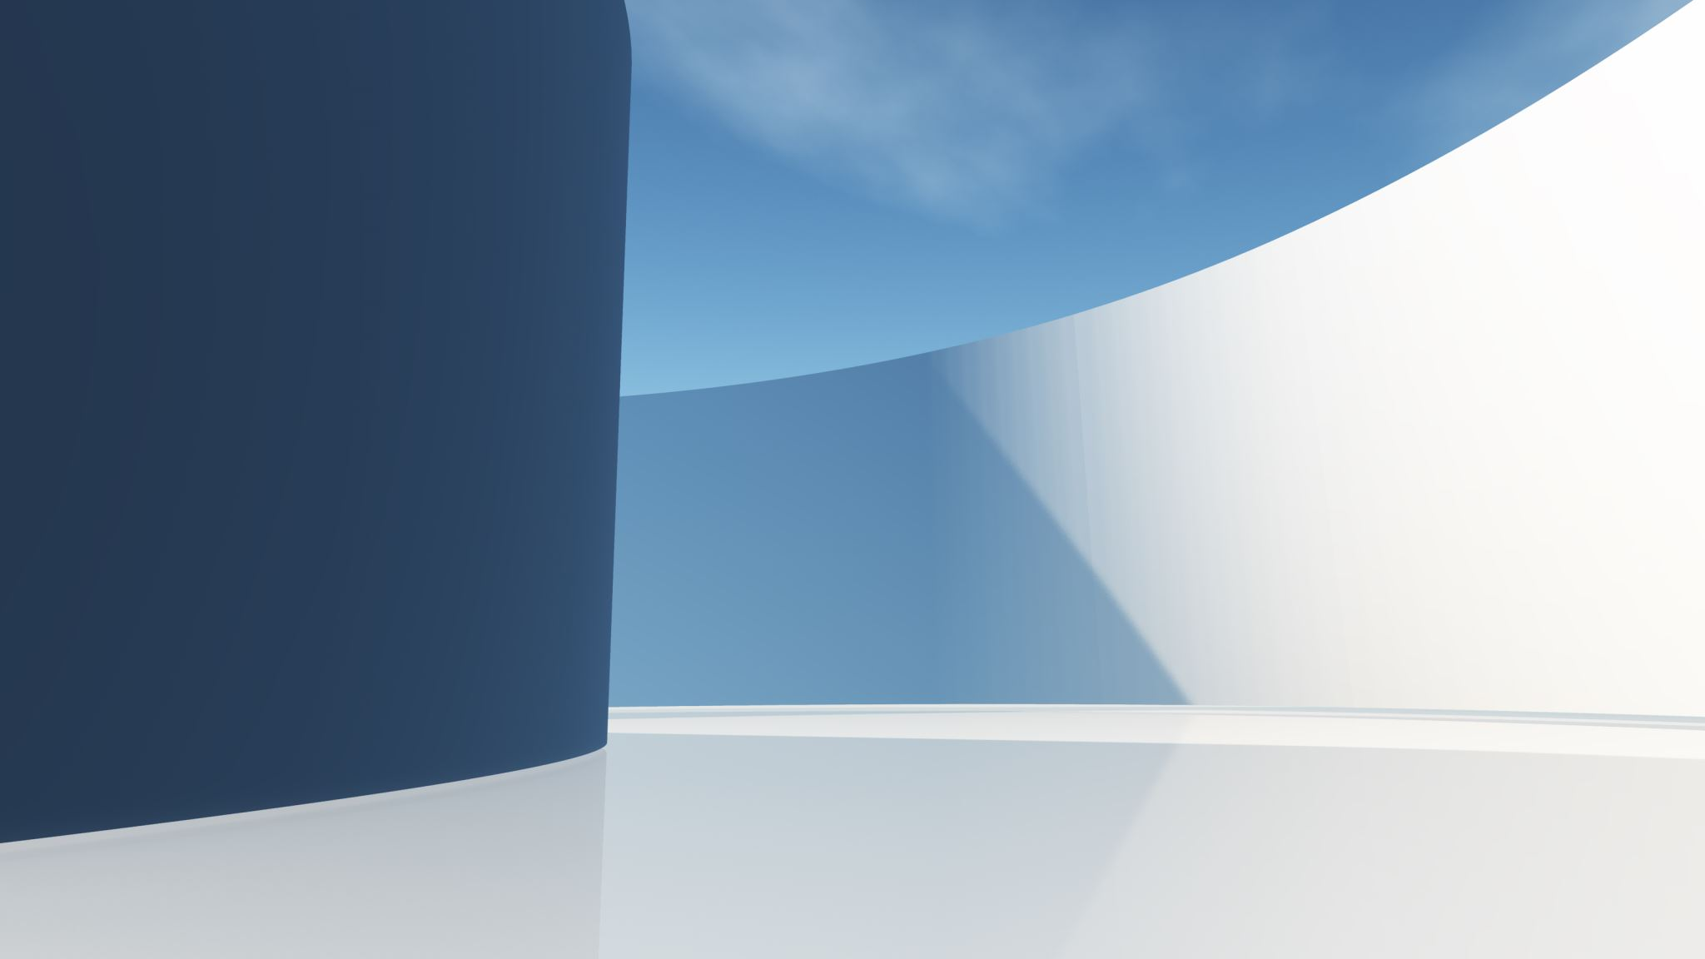
Project 2 – Automated Medical Appointment Booking Assistant
20230003918 Hans Misquitta
20230003374 Badr arabi
20220002085 Hassan mutajba
20210001826 majed alzenati

Slide 2
Structure
Problem
Solution
Paradigms
Implementation
Conclusion and future work

Slide 3

Problem
In today's world, despite the globalization of technology, many struggle to utilize them to the fullest. Majority of such users are elderly or bear physical and mental impairments for whom its difficult to complete even simple tasks such as booking appointments.

Slide 4
Solution
An AI model assistant that utilizes Streamlit for the interface, Python for backend logic, and Lisp for handling symbolic reasoning and decision-making. It accepts user details, intelligently manages context, and books appointments on their behalf. The system is designed to deliver a cleaner, more seamless user experience by combining intuitive interaction with smart automation.

Slide 5
Imperative – Uses explicit commands to manage program flow. Environment variables are used to securely save and access user data. Object-Oriented – Encapsulates AI models and logic into objects. Promotes modular, scalable, and maintainable code structure. Functional – Leverages pure functions for cleaner, reusable code. Improves readability and simplifies debugging. Interactive – Streamlit provides a dynamic UI for real-time input and output. Enables users to interact with models instantly.
Paradigms

Slide 6
Implementation
After accepting user details from the GUI, it is then saved into the .env file. Utilizing this data the program calls an AI model (mistral:latest) to access the site and fill in the form for the user. Since details such as phone number and email are necessary to complete the appointment form, users can confirm success without opening the hospital website.
We have chosen to use LLM to cover potential security issues regarding user data, such as Emirates IDs and contact details. As medical information is private, security measures are always a must.

Slide 7
Conclusion and future work
Through this application we hope to provide more options to those who already struggle with basic technology as well as influence other developers to put higher emphasis to user accessibility.
We hope to add more options and filters to allow users to book appointments across different medical facilities.

Slide 8
Thank you

